Slide 1
CAPSTONE
GENERAL ASSEMBLY
By: Joseph Eng
Github: Aspiring-DataGod9000

Slide 2
TABLE OF CONTENTS
01.
02.
03.
INTRODUCTION
DEMO
PYGAME
04.
05.
06.
MODEL
LIMITATIONS & FUTUREWORKS
PROJECT IMPLICATION

Slide 3
01.
INTRODUCTION

Slide 4
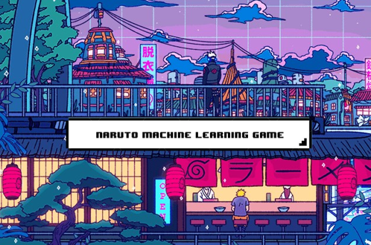
OUR EVOLUTION

Slide 5
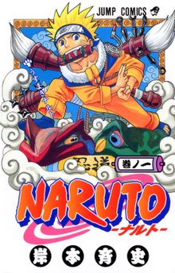
WHAT IS NARUTO?

Slide 6
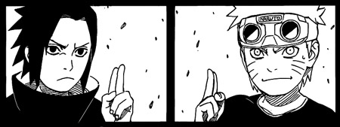
WHAT IS NARUTO?
Authored by Masashi Kishimoto, Naruto is a popular Japanese comic/anime series that follows the tale of young ninja Naruto Uzumaki, who aspires to be recognized by his peers, and become the Hokage (Just as I aspire to be DataGod).

Slide 7
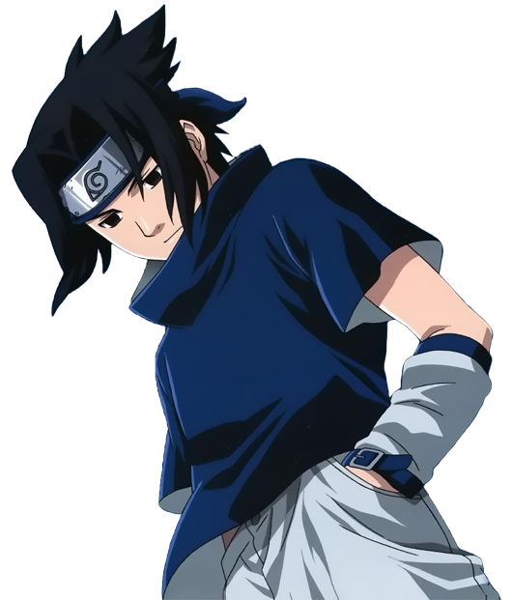
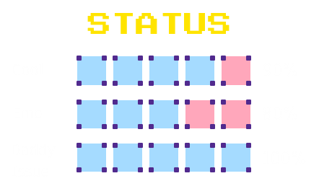
WHO IS SASUKE?
DESCRIPTION
The main character of my game, Sasuke is the last surviving member of his Ninja clan. Dude spent the good-first-half of the series seeking revenge from his brother whom he believes slaughtered his clan and murder their father #TroubledChildhoodCheck.

Slide 8
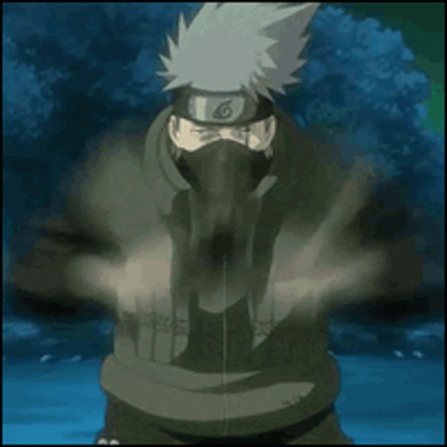
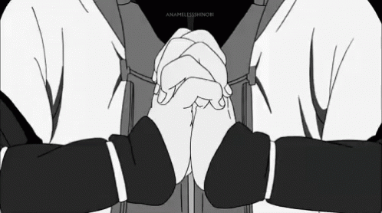
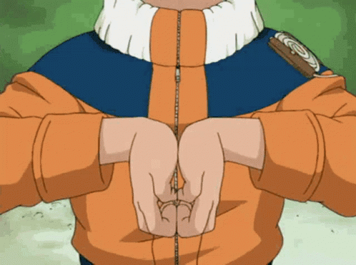
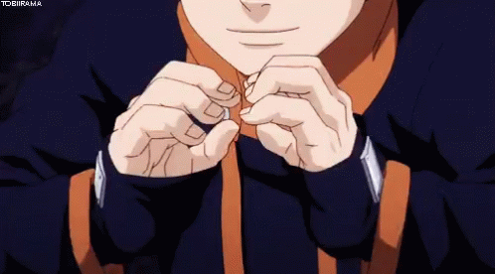
NARUTO OPENCV MACHINE-LEARNING GAME
Plot
This Naruto OpenCV game is a turn-based game which features our best boi Sasuke as the main character. You, as the player, will help Sasuke kick some major bandit butts.
Main Feature
The game uses OpenCV and Machine Learning to allow players to wave ninja handsigns in real life, infront of their webcam, in order to use some of Sasuke's signature ninjitsu in-game.

Slide 9
02.
DEMO

Slide 10
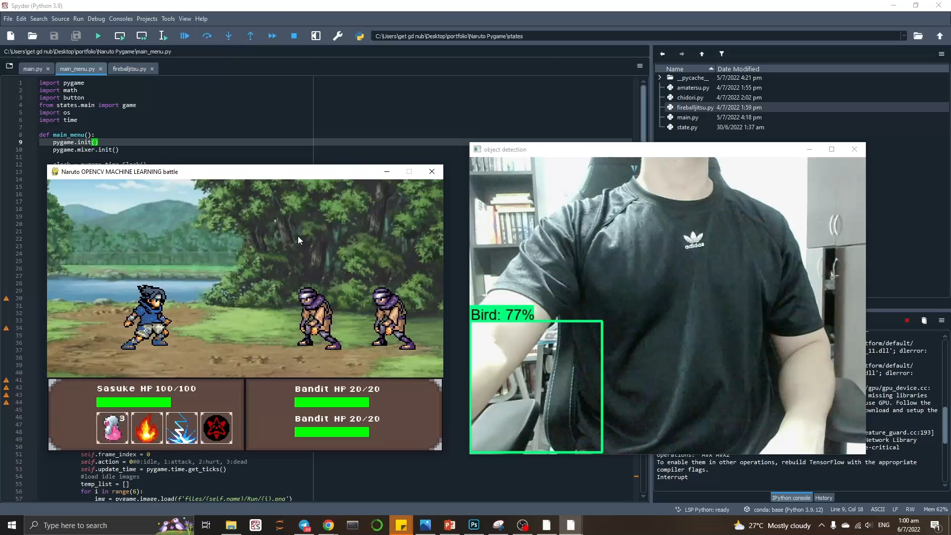
VIDEO DEMO

Slide 11
03.
PYGAME

Slide 12
HOW IT’S MADE
STEP 2
DAY 4
Separating labelled images into train and test folders
Embbed model into pygame
1
2
3
4
STEP 1
DAY 3
Training of model with the image data
Labelling images of myself doing the various Naruto hand signs using LabelImg

Slide 13
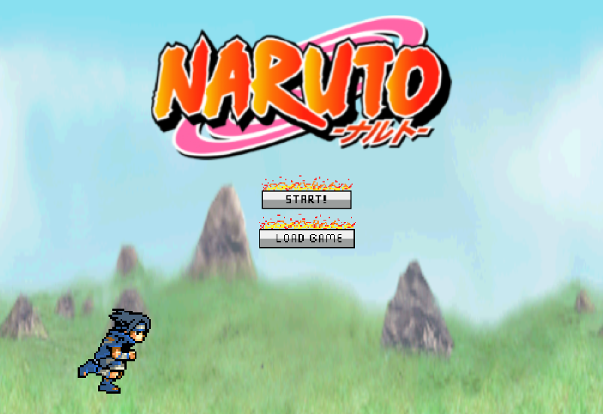

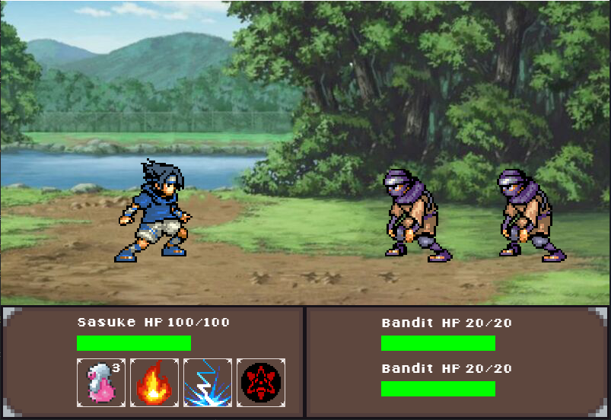
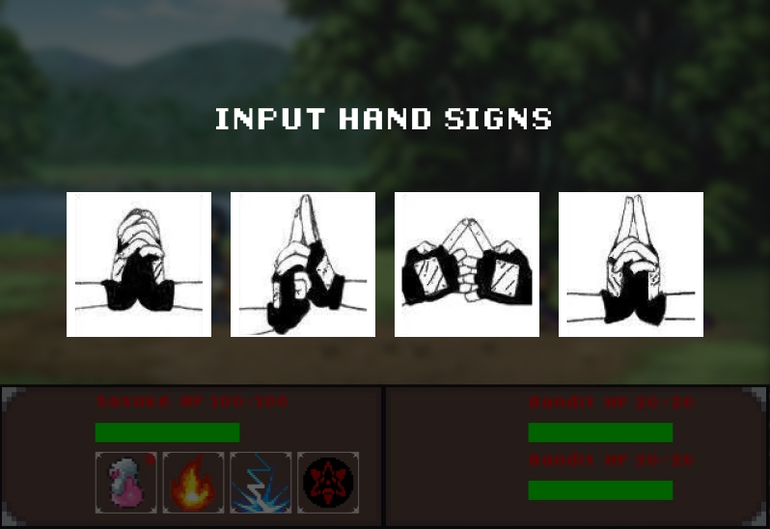
CODING ON PYGAME
1
def main_menu()
def main_game()
2
def jitsu_mode1()
3
def jitsu_mode2()
def jitsu_mode3()

Slide 14
04.
MODEL

Slide 15
SSD MOBILENET V2
Single-stage object detection mobilenet V2 is a one-stage object detection model that uses image pixels and bunding box coordinates to class proabilities. It is a widely used model with great accuracy performance on low compute machines, such as mobile phones, and thus the name Mobilenet.

Slide 16

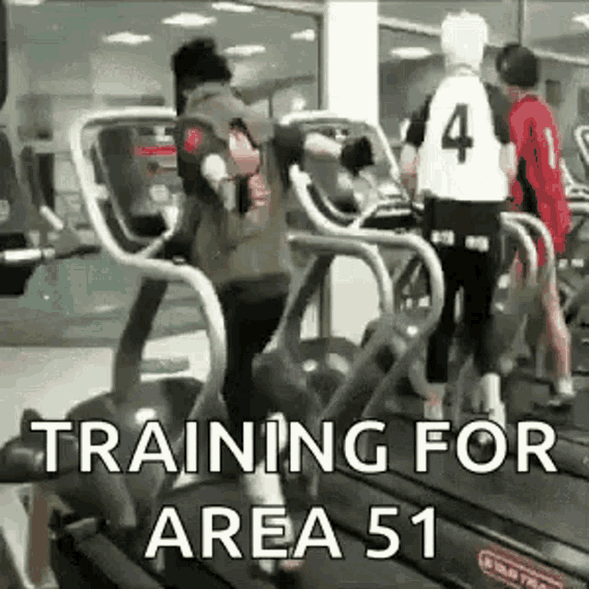
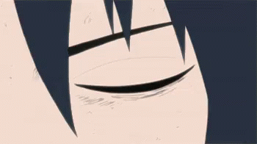
MODELLING PROCESS
Train Data
Model
Training
Prediction in OpenCV
Train model with train data using transfer learning
Embbed trained model into OpenCV for Realtime Object-dection
Test Data

Slide 17
05.
LIMITATIONS & FUTUREWORK

Slide 18
LIMITATIONS & FUTUREWORK
FUTURE FIX
CURRENT LIMITATIONS
FUTURE FIX
S
W
Webcam feed can be masked with background subtraction to feed only black and white images for model training
Accuracy of object_detection drops when wearing shirt other then white and black
CURRENT LIMITATIONS
O
T
google mediapipe line can be used to track poses on hand, extract them, and identify different hand gestures with simple logics codes
Accuracy of object_detection drops when face is shown on the webcam feed

Slide 19
06.
FUTURE
IMPLICATION

Slide 20
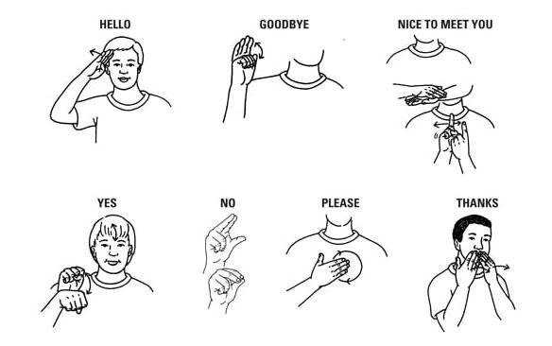
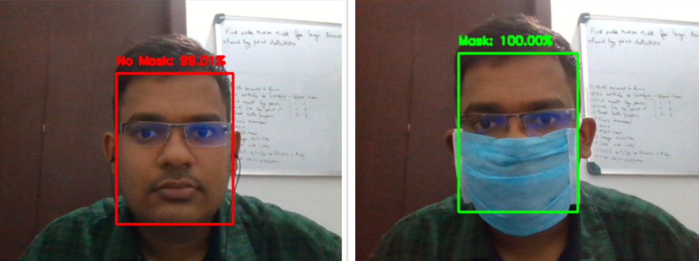
COMPUTER VISION & MACHINE LEARNING
SIGN LANGUAGE TRANSLATION
MASK DETECTION
Detect sign language input and translate them into english
Detect whether someone is wearing a mask or not

Slide 21
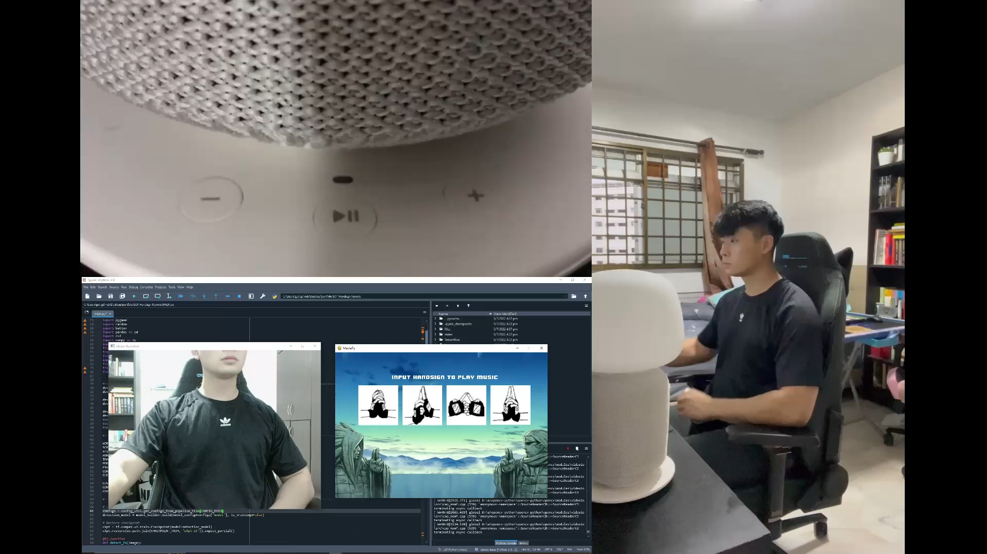
IOT HAND GESTURE REMOTE CONTROL

Slide 22

THANKS!
Aspiring-DataGod9000
Acknowledgements:
1. Nicholas Renotte – Tensorflow Object Detection in 5 hours
2. Learning with Rev – Transfer Learning Mobilenet V2
3. Khush Patel – Custom Object Detection using TensorFlow
4. Jon Fincher – Pygame A Primer on Game
5. CodersLegacy – Python pygame The Full Tutorial
6. Ronald - @seerlight

